Slide 1
Scratch Financial Code Challenge
Saqib Shahabuddin

Slide 2
Goal: Call a endpoint
And search the JSON object that is returned from that endpoint

Slide 3
Asynchronous fetch()
Use fetch()
Call the endpoint - https://storage.googleapis.com/scratchpay-code-challenge/dental-clinics.json
A JSON object is return after fetch
If the connection with the endpoint cannot be found an exception is thrown

Slide 4
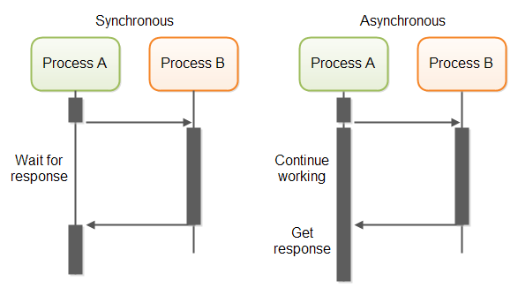
Synchronous Call vs. Asynchronous Call

Slide 5
Search the JSON Object
Use defiant.json.search()
The user’s input is used to search the JSON object for a match
If a match is found that key is returned and all of the information regarding that clinic is displayed
If no match is found, then a messages stating no match is found

Slide 6
CREDITS
Saqib Shahabuddin
Email: sts.shahabuddin@gmail.com
Phone: (909) 260-6310

